Slide 1

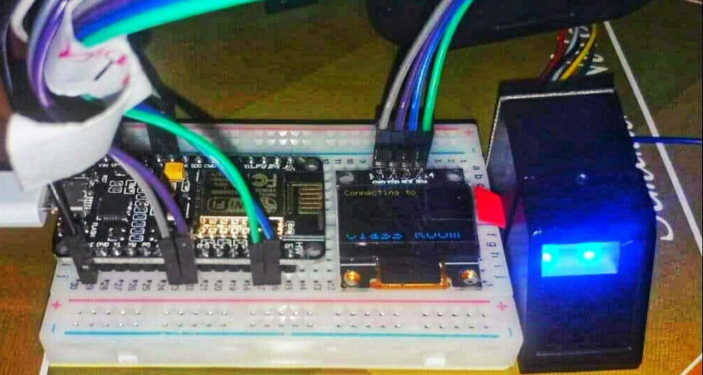
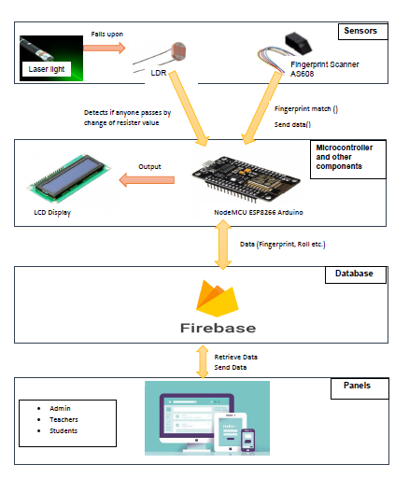
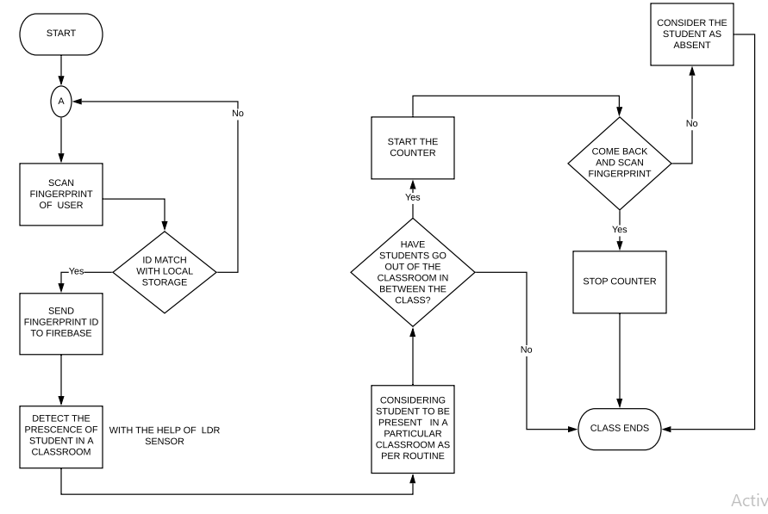
MIST AUTOMATED ATTENDANCE SYSTEM (MAAS)
H. M. Zobyer,, Farzana Faruk, Masrur Hasan, Ariful Islam, Nafiz Imtiaz, Sumaiya Nuha
Department of Computer Science and Engineering
Military Institute of Science and Technology
ABSTRACT
FEATURES
PROTOTYPE
CONCLUSION
The aim of the project is to ensure attendance automatically by using bio-metric (fingerprint) technology. Before entering into a class student will complete fool-proof bio-metric verification which will mark them present in the attendance sheet automatically. So this will save time wasted in calling out names. A web based platform is used on this project where a teacher and students can see the attendance record (percentage, fine, eligibility for exam etc.) from this platform based on accessibility. Proxy, skipping classes & late coming will be handled using sensors so it will keep track of the valid attendance records.
Biometric based automated attendance for each class.
Storing data in a real time cloud based database.
Online application system.
Real time report generation.
Course wise fine and eligible student list generation.
Personal and class wise real time statistics generation.
Personal profile for each student, teacher and admin personals and access to data through their respective panels.
Mist Automated Attendance System (MAAS) is more precise and accurate with the attendance comparing with the previous manual system . is a generalized system for making the attendance taking process automated. MAAS provides flexibility to the stakeholder’s preference. It also minimizes physical report and handling cases affiliated to the institution. The system is more transparent to all side of the users including: teacher, student and admin personals. As per implementation of the system we will be preferring MAAS should be easily applicable for any institution
INTRODUCTION
SYSTEM ARCHITECTURE
WORK FLOW
FUTURE WORK
Attendance record means a summary of the pupil's attendance during the period to which the information relates, showing the total number of possible attendances and the total number of unauthorized absences. Nowadays attendance is ensured by calling out the names which is more time consuming. Moreover sometimes it is tough for a teacher to prevent proxy and identify whether someone is entering late in the classroom or leaving the class before the finishing time. Automatic attendance system will ensure attendance each time a class starts and proxy is impossible as the attendance will count through biometric verification. Teacher is authorized to edit the attendance. So this platform will handle attendance related task automatically after ending of each class and total attendance record after each term for the teacher and as well as for students which will decrease attendance related complexity
The future extent of MAAS is to implement door locking system along with automated biometric attendance. The minor cases of failures and errors encountered in the system. These problems can be addressed by implementing door locking system. For implementing this extension with the existing system, proper feasibility analysis must need to be done so that the extended system become time efficient as well as secured
REFERENCES
[1] “How fingerprint scanners work - optical, capacitive, and other variants”. [Online].Available: https://www.androidauthority.com/how-fingerprint-scanners-work-670934/
[2]“Student Scheduling & Logistics Software Solutions”. [Online]. Available: https://www.schoolpass.com/product-tour/.
[4] Clavereau, M. (2011). Absence: time to tackle the root causes. Retrieved 15th October, 2013 from http://www.hrmagazine.co.uk Dale, M. R. (2005). A Process for Combining Structured Analysis and Object Oriented Design. Retrieved 10th February, 2013 from
[5] http://www.dtic.mil/ndia/systems/Rickman2.pdf. Dan, P. and Neil, P. (2005). UML 2.0 in a Nutshell. O'Reilly publication. ISBN: 0-596-00795-7. Dubin, C. (2011). "Biometrics: Hands Down, ID Management". 30th March 2013
[6] http://www.smartcardalliance.org. Wayman, J. L., Jain, A. K., Maltoni, D., and Maio, D. (2005). Biometric Systems: Technology, Design and Performance Evaluation, Attendance Monitoring System Using Biometrics for Security Staff, studymode Inspiring.
OBJECTIVE
COST ANALYSIS
DISCUSSION
Objectives to be achieved from MAAS:
To ensure maximum secure attendance by biometrics technology.
To make it easy for both students and teachers to know about their attendance.
To reduce late coming tendency.
To reduce the trouble of manual application system for leave.
To reduce wastage of time during manual roll calling system.
The system stated above is fingerprint based attendance system. The previous automated system were based on RFID and implementation of this system were in some corporate offices. In spite of having an existing system the new system differ to the previous systems. In old RFID based system, there was a major drawback that a person need to manually monitor when a particular ID card is being punched. Again, time taken by previous systems were more than the new one. Unique feature of MAAS is online application system so that student can easily submit their application to the respective teacher.
Objectives to be achieved from MAAS:
To make an efficient biometric based automated attendance system
To make it easy for both students and teachers to know about their attendance.
To reduce late coming tendency.
To reduce the trouble of manual application system for leave.
To reduce wastage of time during manual roll calling system.
Ser. No | Items | Cost
1 | Cost of Equipment | 6700
2 | Field Work | 500
3 | Typing, Drafting Binding & paper etc. | 1000
Total Amount |  | 8200
.
Table 1: Cost for prototype

Slide 2

MIST AUTOMATED ATTENDANCE SYSTEM (MAAS)
H. M. Zobyer,, Farzana Faruk, Masrur Hasan, Ariful Islam, Nafiz Imtiaz, Sumaiya Nuha
Department of Computer Science and Engineering
Military Institute of Science and Technology
ABSTRACT
FEATURES
PROTOTYPE
CONCLUSION
The aim of the project is to ensure attendance automatically by using bio-metric (fingerprint) technology. Before entering into a class student will complete fool-proof bio-metric verification which will mark them present in the attendance sheet automatically. So this will save time wasted in calling out names. A web based platform is used on this project where a teacher and students can see the attendance record (percentage, fine, eligibility for exam etc.) from this platform based on accessibility. Proxy, skipping classes & late coming will be handled using sensors so it will keep track of the valid attendance records.
Biometric based automated attendance for each class.
Storing data in a real time cloud based database.
Online application system.
Real time report generation.
Course wise fine and eligible student list generation.
Personal and class wise real time statistics generation.
Personal profile for each student, teacher and admin personals and access to data through their respective panels.
Mist Automated Attendance System (MAAS) is more precise and accurate with the attendance comparing with the previous manual system . is a generalized system for making the attendance taking process automated. MAAS provides flexibility to the stakeholder’s preference. It also minimizes physical report and handling cases affiliated to the institution. The system is more transparent to all side of the users including: teacher, student and admin personals. As per implementation of the system we will be preferring MAAS should be easily applicable for any institution
INTRODUCTION
SYSTEM ARCHITECTURE
WORK FLOW
FUTURE WORK
Attendance record means a summary of the pupil's attendance during the period to which the information relates, showing the total number of possible attendances and the total number of unauthorized absences. Nowadays attendance is ensured by calling out the names which is more time consuming. Moreover sometimes it is tough for a teacher to prevent proxy and identify whether someone is entering late in the classroom or leaving the class before the finishing time. Automatic attendance system will ensure attendance each time a class starts and proxy is impossible as the attendance will count through biometric verification. Teacher is authorized to edit the attendance. So this platform will handle attendance related task automatically after ending of each class and total attendance record after each term for the teacher and as well as for students which will decrease attendance related complexity
The future extent of MAAS is to implement door locking system along with automated biometric attendance. The minor cases of failures and errors encountered in the system. These problems can be addressed by implementing door locking system. For implementing this extension with the existing system, proper feasibility analysis must need to be done so that the extended system become time efficient as well as secured
REFERENCES
[1] “How fingerprint scanners work - optical, capacitive, and other variants”. [Online].Available: https://www.androidauthority.com/how-fingerprint-scanners-work-670934/
[2]“Student Scheduling & Logistics Software Solutions”. [Online]. Available: https://www.schoolpass.com/product-tour/.
[4] Clavereau, M. (2011). Absence: time to tackle the root causes. Retrieved 15th October, 2013 from http://www.hrmagazine.co.uk Dale, M. R. (2005). A Process for Combining Structured Analysis and Object Oriented Design. Retrieved 10th February, 2013 from
[5] http://www.dtic.mil/ndia/systems/Rickman2.pdf. Dan, P. and Neil, P. (2005). UML 2.0 in a Nutshell. O'Reilly publication. ISBN: 0-596-00795-7. Dubin, C. (2011). "Biometrics: Hands Down, ID Management". 30th March 2013
[6] http://www.smartcardalliance.org. Wayman, J. L., Jain, A. K., Maltoni, D., and Maio, D. (2005). Biometric Systems: Technology, Design and Performance Evaluation, Attendance Monitoring System Using Biometrics for Security Staff, studymode Inspiring.
OBJECTIVE
COST ANALYSIS
DISCUSSION
Objectives to be achieved from MAAS:
To ensure maximum secure attendance by biometrics technology.
To make it easy for both students and teachers to know about their attendance.
To reduce late coming tendency.
To reduce the trouble of manual application system for leave.
To reduce wastage of time during manual roll calling system.
The system stated above is fingerprint based attendance system. The previous automated system were based on RFID and implementation of this system were in some corporate offices. In spite of having an existing system the new system differ to the previous systems. In old RFID based system, there was a major drawback that a person need to manually monitor when a particular ID card is being punched. Again, time taken by previous systems were more than the new one. Unique feature of MAAS is online application system so that student can easily submit their application to the respective teacher.
Objectives to be achieved from MAAS:
To make an efficient biometric based automated attendance system
To make it easy for both students and teachers to know about their attendance.
To reduce late coming tendency.
To reduce the trouble of manual application system for leave.
To reduce wastage of time during manual roll calling system.
Ser. No | Items | Cost
1 | Cost of Equipment | 6700
2 | Field Work | 500
3 | Typing, Drafting Binding & paper etc. | 1000
Total Amount |  | 8200
.
Table 1: Cost for prototype

